Slide 1

Teradata Data Warehouse Appliance 2850
Customer Overview Deck
Presenter Name, Presenter Title
Date

Slide 2


Remove slide before presenting or sending to customer
Don’t let these bite you!
The 2850 does not have hardware compression cards. HW compression was removed with the 2800 and replaced with improved software compression.
Field-installable options include additional 2800/2850 system(s), Data Mart Appliance(s), SAS, Teradata Aster, Hadoop nodes, and BAR storage (tape or disk). Additional items will go in the Platform Framework Cabinet.

Slide 3

Agenda
Data Warehouse Appliance 2850 Overview
Features and Specs
3
© 2014 Teradata

Slide 4

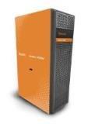
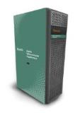


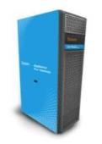
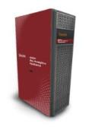
Teradata Enterprise Platforms
6800
2850
Appliance for Hadoop
Analytics Appliance
680
1800
 | Integrated Data Warehouse |  |  |  | Data Platform |  | Discovery
Series | IntelliFlex | 6000 | 2000 | 600 | 1000 | Hadoop | Aster
Purpose | Stage 3-5 Balanced Active Data Warehouse | Stage 3-5 Balanced Active Data Warehouse | Stage 1-3+ Scalable Data Warehouse | Cost Effective, Single node Teradata | One Platform, Many Uses | Appliance for Hadoop | Integrated high performance, multi-genre analytic platform designed to scale
Workloads | Active EDW workloads with more flexible price/ performance configs | Strategic & Operational Intelligence, Very High Concurrency Active, Real Time Update | Strategic Intelligence, DSS, Fast Scan, Moderate Concurrency Active | Test/ Development, Small Data Warehouse | IDW Offload, Deep Dive Analytics, Data Storage, Discovery, DR, ETL, Low Concurrency | Storing, Capturing, and Refining Data | Aster Analytics and Hadoop for integrated SQL, Map-Reduce, Graph, and R analytics
Software | Teradata Database |  |  |  |  | Hortonworks Cloudera | Aster Database
Notes:
This is a succinct chart of the main hardware platforms Teradata sells, with some additional information on each platform’s purpose and intended workloads. The specific current model number is listed at the top beside the graphics, while the series number is the first row. While the latest model changes every year or so, the 6000 series, for example, will consistently be for Stages 3-5 balanced Active Data Warehousing.

Slide 5
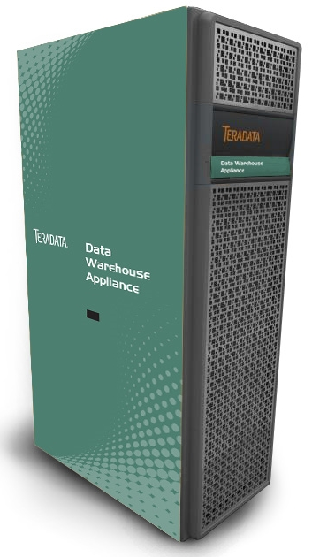
Teradata Data Warehouse Appliance Overview
High-Performance Analytics
Powerful enterprise data warehouse solution for timely DSS, BI, and Analytics
Enterprise concurrency – hundreds of users and events
Effortless Scalability
Simple building block approach to growth
Better Security with Full Disk Encryption
Data is encrypted at the disk level for added security
Best-in-Class Workload Management
Workload Classifications, Flexible Priorities, I/O Resource Management, Service Level Goal Workload Reports added with SLES11
Cost Effective & Versatile
Best in class price/performance
Multiple applications on a single platform; multiple technologies in a single cabinet
Integrated data warehouse, test/dev, disaster recovery, ELT offload
Operational Availability
System availability with automatic node failover and recovery
Fully redundant with hot swap components
Investment Protection
Leverage future generations with co-residence
Notes:
8/15/2016
5
The Teradata Data Warehouse Appliance is a high performance data warehouse solution for timely Decision Support, business intelligence, and analytics. It’s an appliance solution, so all software, hardware, and networking are pre-packaged in fixed, scalable configurations into a base cabinet and delivered ready to run. It offers superior concurrency, scalability, security, and runs the industry leading Teradata database with our best-in-class workload management. Teradata appliances are cost-effective and versatile in that they can perform a multitude of tasks ranging from a small data mart all the way up to a production integrated data warehouse with many users. Teradata always uses the latest processor and storage technology, so customers know they are truly getting the best possible technical solution in the market place.

Slide 6
Introducing the Teradata Data Warehouse Appliance 2850 Optimized for Fast In-Memory Processing
More In-Memory Processing
Increased Query Throughput
Exceptional Configuration Flexibility
Notes:
More In-Memory Processing – Up to 1TB of memory per node enables more hot data space.
Increased Query Throughput – 10% increase in drive count (40 to 44) will enable more I/O.
Exceptional Flexibility – Two drive sizes available: 600GB & 1200GB, to best meet performance/capacity requirements. Ability to add up to three additional Teradata systems (Data Warehouse Appliance 2800/2850 & Data Mart Appliance 680), plus SAS, Teradata Aster, Hadoop, and/or BAR storage to the base cabinet.
Note: performance numbers are estimates.

Slide 7
Introducing the Teradata Data Warehouse Appliance 2850 Optimized for Fast In-Memory Processing
More In-Memory Processing
More memory per node – up to 1TB - enables more hot data to be kept in memory for faster query response times
Increased Query Throughput by 15%
More Powerful CPU: Dual 18-core Intel® Xeon® with 28% more cores enables a 25% increase in CPU power
Improved I/O profile: 10% more disks/node enable faster query response and full scans and 10% more AMPs
Exceptional Configuration Flexibility
Two drive sizes (600GB and 1.2TB)
Optional additional systems in base cabinet: 28xx system(s), Data Mart Appliance 680(s), BAR storage, Teradata Aster / Hadoop / SAS nodes, or Multipurpose servers.
New network topology with cascading switches results in a more efficient cabinet footprint and lower cost.
Notes:
More In-Memory Processing – Up to 1TB of memory per node enables more hot data space.
Increased Query Throughput – More powerful CPU and 10% increase in drive count (40 to 44)
Exceptional Flexibility – Two drive sizes available: 600GB & 1200GB, to best meet performance/capacity requirements. Ability to add up to three additional Teradata systems (Data Warehouse Appliance 2800/2850 & Data Mart Appliance 680), plus SAS, Teradata Aster, Hadoop nodes, and/or BAR storage to the base cabinet.
Note: performance numbers are estimates and will vary depending on workload types.

Slide 8
Agenda
Data Warehouse Appliance 2850 Overview
Features and Specs
8
© 2014 Teradata

Slide 9
2850 Overview Features & Benefits
2850 Base Cabinet
3 x (4+0) Cliques
BYNET V5 Only
24 Port 1 GbE SM Switch - Secondary
Storage
Storage
Database Node
Database Node
Database Node
Database Node
Storage
Storage
Storage
Storage
Database Node
Database Node
36 Port IB Switch or Blank
No Chassis Allowed
36 Port IB Switch or Blank
KMM
System VMS
Database Node
Database Node
Storage
Storage
Database Node
Database Node
Database Node
Database Node
Storage
Storage
Storage
Storage
24 Port 1 GbE SM Switch - Primary
Dell Node with 18-Core Intel® Xeon® CPU
Estimated ~ 25% CPU performance uplift from prior gen processors
Fast 512GB & 1TB DDR4 memory (up to 12TB in single cabinet)
Seagate Arrays with High-Density Enclosures
Double-density, 48-drive 2U enclosures
44 drives/node (10% increase from 2800 enables more I/O)
600GB & 1.2TB drive sizes
2 Global Hot Spares per array included as an every unit item for faster recovery
Support for Multiple Systems in 2850 Base Cabinet
Additional 28xx systems or Data Mart Appliance 680(s) can be configured for installation into the base cabinet
Teradata Aster, Hadoop, SAS nodes, Teradata Multipurpose Servers, & BAR Storage also supported
Notes:
256GB memory also available.

Slide 10
Teradata Data Warehouse Appliance 2850 Technical Specifications
Nodes | Twelve MPP Nodes Per Cabinet Dual 2.3 GHz Eighteen Core Xeon Processors
Storage | (528) 600 or 1.2TB SAS Drives per cabinet
Total User Data Capacity per cabinet (Uncompressed) | 100TB – 600GB drives 200TB – 1.2TB drives
Scalability | Up to 36 Nodes on BYNET v5 (IB): Internal Switch 300TB - 600GB 600TB - 1.2TB Max Config 2,048 Nodes - BYNET v5 with External Switch 17PB - 600GB 34PB - 1.2TB
Availability | RAID1, Node Failover with Cliquing, BAR
Operating System | SUSE Linux - SLES11
Database | Teradata 15.10.01 or higher
System Management | Single Operational View Across Complete System
Interconnect | Teradata BYNET® v5 over InfiniBand
Notes:
10

Slide 11
2750 - 2850 High-Level Comparison (Cabinet-Level, Base Configurations)
 | 2750 | 2800 | 2850
# of Cabinets | 1 | 1 | 1
# of Drives | 216 drives (300, 600, 900GB) | 480 drives (576 slots) (300, 600, 900GB) | 528 drives (576 slots) (600,1200GB)
TB User Data (Uncompressed) | 20.6TB – 300GB 41.2TB – 600GB 61.7TB – 900GB | 45.8TB – 300GB 91.5TB – 600GB 137.3TB – 900GB 182TB – 1200GB | 100TB – 600GB 200TB – 1200GB
# of Nodes | 6 | 12 (+100%) | 12
Drives Per Node | 36 | 40 (+11%) | 44 (+10%)
Memory | 3TB | 6TB (+100%) | 12TB (+100%)
Processor Cores | Ivy Bridge - 2.7 GHz 144 cores | Haswell - 2.6GHz 336 cores (+133%) | Broadwell - 2.3GHz 432 cores (+30%)
80% Read I/O | ~2.8 GB/s | ~ 6.9 GB/s (+148%) | ~8.5 GB/s (+22%)
Interconnect Options | 1Gb BYNET over Eth QDR InfiniBand | FDR-10 InfiniBand | FDR-10 InfiniBand
Notes:
A typical workload is estimated at 80% reads, 20% writes.

Slide 12
2750 - 2850 High-Level Comparison (Node-Level, Base Configurations)
 | 2750 | 2800 | 2850
Drives Per Node | 36 drives (300, 600, 900GB) | 40 drives (300, 600, 900GB) | 44 drives (600GB, 1200GB)
TB User Data (Uncompressed) | 3.4TB – 300GB 6.9TB – 600GB 10.3TB – 900GB | 3.8TB – 300GB 7.6TB – 600GB 11.4TB – 900GB 15TB – 1200GB | 8.3TB – 600GB 16.7TB – 1200GB
Max Memory | 512GB | 512GB | 1TB (+100%)
Processor Cores | Ivy Bridge - 2.7 GHz 24 cores | Haswell - 2.6GHz 28 cores (+16%) | Broadwell - 2.3GHz 36 cores (+28%)
80% Read IO | ~0.47 GB/s | ~0.58 GB/s (+23%) | ~0.7 GB/s (21%)
Interconnect Options | 1Gb BYNET over Eth QDR InfiniBand | FDR-10 InfiniBand | FDR-10 InfiniBand
Notes:
Comparison on a node level.

Slide 13
Packaging – What’s Included?
2850 Base Cabinet
3 x (4+0) Cliques
BYNET V5 Only
24 Port 1 GbE SM Switch - Secondary
Storage
Storage
Database Node
Database Node
Database Node
Database Node
Storage
Storage
Storage
Storage
Database Node
Database Node
36 Port IB Switch or Blank
No Chassis Allowed
36 Port IB Switch or Blank
KMM
System VMS
Database Node
Database Node
Storage
Storage
Database Node
Database Node
Database Node
Database Node
Storage
Storage
Storage
Storage
24 Port 1 GbE SM Switch - Primary
Hardware
(4) node cliques (up to 3); ½ clique available
HDD Storage
(2) global hot spare drives per array, up to (12) per cabinet
(2) Dedicated 36-port BYNET V5 switches
(2) 24-port Server Management switches
(1) VMS
System VMS in Base, optional Cabinet VMS in subsequent cabinets
(1) Keyboard/Monitor/Mouse in Base cabinet
Software
Teradata Database 15.10.01 and higher
TTU 15.10 and higher
Viewpoint
SLES 11
Data Stream Utility
Optional
28xx System(s)
Teradata Aster / Hadoop / SAS nodes
BAR: i80 Tape Library / Data Domain 4200
Data Mart Appliance 680(s)
Data-at-Rest Encryption in Storage Arrays and Servers
Temporal, Columnar, Row-Level Security, Teradata TPump / PT Stream Operator, Teradata Query Grid
Notes:
The cabinet is fully configured with all node, storage, power, and server management hardware components. All software you need to get started is included, and there are optional hardware items and software bundles you can add.
There are six drive arrays, with two drive trays each.

Slide 14
Why Backup Your Teradata Appliance? It’s About Being Prepared
Business Continuity: conform to enterprise IT objectives for system recovery
Recovery Time Objective – RTO
Service level time window in which a system and data must be restored
Major business impact for failure to meet the required time
Recovery Point Objective – RPO
Point in time to which a system must be restored for acceptable impact to users
Determines how current the recovered system data must be
Frequency of backup operations is key with data loss
Regulatory Compliance – a global need
Global requirements for long-term access to business records
Sarbanes-Oxley – Seven years of financial record history
Basel II, HIPAA, etc., require long-term record retention
Data warehouse is a strategic component in business operations
Time consuming to rebuild data warehouse from multiple original sources
Embedded business intelligence is hard to recreate
Notes:
Businesses have many requirements for recovering their system and restoring data, usually designated in a time to functionality (in hours/days) or a point in time (must restore the previous day’s data). There are so many regulations now dictating how much data companies must keep. And finally, data warehouses contain a lot of very important, often business-critical, information that would be difficult and time-consuming to recreate from scratch.

Slide 15
Teradata Data Protection Options
Teradata BAR Solution
Designed, sourced, implemented, and supported by Teradata
A single BAR solution can support multiple Teradata systems
Advocated BAR provides a robust, fully managed backup, archive, and restore solution
Designed, sourced, implemented, and fully supported by Teradata to meet customer SLA’s
Enterprise Fit allows Teradata BAR output to integrate with a customer’s enterprise solution
Customer supplies some or most of the backup infrastructure
Teradata only supports the Teradata-sourced components
Data Stream Utility
Included with every non-EDW system, the DSU is a no-cost tool that exports data to your existing data protection environment
Provides the customer with the option of fully managing the entire data protection solution
Notes:
There are two routes for protecting the Teradata Data Warehouse Appliance 2850. The most robust solution, and generally the preferred solution for customers is a true BAR configuration. This is managed, integrated backup and restore. Customers have a choice of going with a full Teradata system, called our “Advocated” solution (or, at a lower performance level or with older equipment, called “Certified”), or supplying/managing a part of the solution themselves, called the Enterprise Fit solution. Alternatively, for smaller Appliance systems or for customers who don’t use one of our three supported backup applications, the Data Stream Utility is available free of charge on every Appliance platform.

Slide 16



Teradata Advocated BAR Solution Products for the Data Warehouse Appliance 2850
DISK
Data Domain DD4200
Also Supports DSU
TAPE
Quantum Scalar i80
 | i80
Maximum capacity (usable) | 240 TB
Tape Slots | 50-80
Drives | 1-5 Half Height
Tape Technology | LTO6
Encryption | Scalar Key Manager
 | DD4200
Maximum physical capacity (usable) | 180 TB
Maximum performance (compressed) | ~4 TB per hour
Data Deduplication Rate | 3-6x
Replication
Encryption
Notes:
While any of our BAR products will work with the Data Warehouse Appliance, we have smaller, more cost-effective models of both tape and disk backup solutions available.

Slide 17
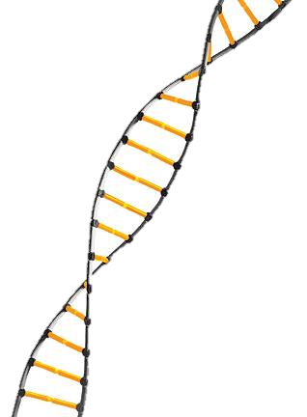
Data Stream Utility
Simple to Use
Operating system and backup application independent
Ready to run on your Teradata node
One button backup and restore
Fast Data Export Capability
Up to 380MB/s per Teradata Data Warehouse Appliance 2850 node {1,520MB/s per 4 node clique}
Cost Effective
Leverage your existing backup infrastructure
Bundled with appliance software at no extra cost
Customer installable
Optional DSU implementation service available
Notes:
17
The Data Stream Utility was created to give Appliance customers more flexibility in how they backup Teradata. It is installed on all current Appliance and SMP nodes and is no additional product cost to the customer. But the DSU is different from Teradata Backup and Restore (BAR). BAR is fully managed protection with many value-added features, functions, and industry-leading software/hardware and comes with intensive consultation and support from Teradata personnel. Customers using the DSU can either fully support their entire data protection infrastructure themselves or buy support and Data Domain hardware from Teradata – this is very different from Teradata BAR, where design, implementation, performance tuning, and help with support issues are all included in the solution.

Slide 18

Investment Protection Co-Residence Only
Data Warehouse Appliance 2850 supports two generations with co-residence
Customers can expand 2750/2800 systems
RAID-1 only
Requires moving to TD 15.10 and SLES11
Supported with both BYNET over Ethernet and InfiniBand
Total system size with Ethernet limited to 22 nodes.
Notes:
The investment protection strategy for the appliance line is co-residence which means that two generations can run together in the same system, but the newer generation will run at the same performance level as the existing platform. This differs from co-existence in the 6000 series, which means every generation runs at a balanced performance with up to three generations of nodes. Co-residence requires moving the older system to Teradata 15.10 and SLES11 and both BYNET over Ethernet and BYNET over InfiniBand are supported.

Slide 19
Teradata BYNET® V5 on InfiniBand Performance
Faster Complex Query Performance
Queries with row redistributions in joins
Faster Data Loading
Throughput
(Higher is better)
Latency
(Lower is better)
10,000
10,000
8,000
6,000
4,000
2,000
0
20
15
10
5
0
20
85% Lower
20X Higher
Mbytes/Second
Microseconds
10
10
3470
960
462
3
BYNET V5 BYNET V4 10GbENet 1GbENet
BYNET V5 BYNET V4 10GbENet 1GbENet
Performance Comparison
Teradata BYNET® V5 vs. 1GbE
Notes:
The performance available with BYNET V5 is illustrated in the charts on the lower half of this slide.
There will be immediate improvement benefit in areas such as row redistributions in joins or loads, with testing on InfiniBand showing 3X versus BYNET V4 for a join.
Other areas include FastLoad phase 1, FastExport, reconfigurations. FastLoad 2X faster in our testing.
Note that many existing Teradata customers have not come close to stressing the BYNET V4 to the maximum yet. In these cases, InfiniBand provides a little benefit. Customers who seriously stress the BYNET V4 hardware such as large systems, will find InfiniBand adds performance value on some workloads – but not all.
19

Slide 20
Write Back Cache
Improves the performance of “writes” to the database
Improvement on Data Loads and Updates
How does it work?
Previously, to ensure data protection/integrity the disk controller needed to fully commit the write to disk prior to acknowledging write completion to node
With Write Back Cache, for data protection the disk controller mirrors the data to be written to the alternate controller’s Write Cache protected memory
Writing to Write Cache memory is much faster than to disk
Teradata also integrates an external battery pack onto the controller in case of power loss
Notes:
20

Slide 21
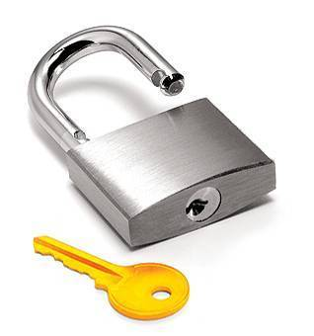
Full Disk Encryption
Protects against data corruption, loss, or theft of individual disk drives
Enhanced security
Compliance laws and regulations
Data encryption is done at the disk level, and has zero impact on overall performance
HDD storage drives only (data drives)
When encrypted, data on drives can’t be read or written to without authentication key
FDE also allows for disk drives to be wiped clean when being decommissioned
Notes:
21

Slide 22

Teradata Customer Support Advantages
Single vendor support for entire solution
Requires no third-party coordination
Trained, experienced customer service reps
100% Teradata employees
Certified regional and global Customer Care Centers
Staffed 7x24
Secure VPN provided
Teradata ServiceConnect
Notes:
8/15/2016
22
22
Teradata Customer Support Advantages:
Teradata delivers data warehouse solutions with a single vendor approach. Teradata supports, certifies, and configures the entire solution. This single vendor support gives you the confidence that problems will be resolved quickly without finger pointing. Teradata does not rely on third parties to support and install our solutions. With Teradata it is one-stop shopping.
We have certified regional and global customer care centers that are staffed with Teradata personal 7x24 ensuring that we’re available when you need support.
Teradata Customer Support can quickly diagnose system issues with Teradata Vital Infrastructure. Teradata Vital Infrastructure provides robust system event and state collection and diagnostic capabilities through remote monitoring. This is all done through Teradata ServiceConnect for secure VPN connectivity through your firewall.

Slide 23
Teradata Premier Support
Teradata Premier Support is world-class software and hardware maintenance and support with reactive incident management
Provides customers with rapid restoration of their system to an operational level
Teradata utilizes highly developed processes, focused resources experienced in supporting highly available systems to deliver world-class maintenance and support
Notes:
23

Slide 24
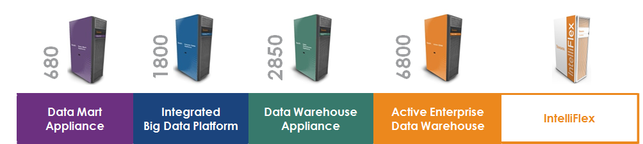
Teradata Enterprise Platform Family The Standard for Unified Data Architecture
We’ve Got You Covered
Teradata offers an enterprise class platform family to meet your analytical system requirements
Complete application and data portability between platforms
Integrated Data Warehouses - shared data environments to run your business
Data Mart Appliance 680
Test/Development for the EDW, Departmental Data Mart
Data Warehouse Appliance 2850
Enterprise Data Warehouse, Strategic Intelligence, Decision Support
Active Enterprise Data Warehouse 6800
Active workloads: strategic and operational intelligence to drive competitive advantage
IntelliFlex™
Active EDW workloads with revolutionary flexibility and scalability
Data Platform - Load, store, and refine data for analytics
Integrated Big Data Platform1800
Cost-effective analytics on large volumes of data
Notes:
8/15/2016
24
24

